Slide 1


INTRODUCTION TO FLUTTER WIDGETS
BUILDING BLOCKS OF BEAUTIFUL APPS
Notes:
Hello everyone, welcome to our session on "Introduction to Flutter Widgets." Today, we'll delve into the fundamental building blocks of Flutter app development: widgets

Slide 2
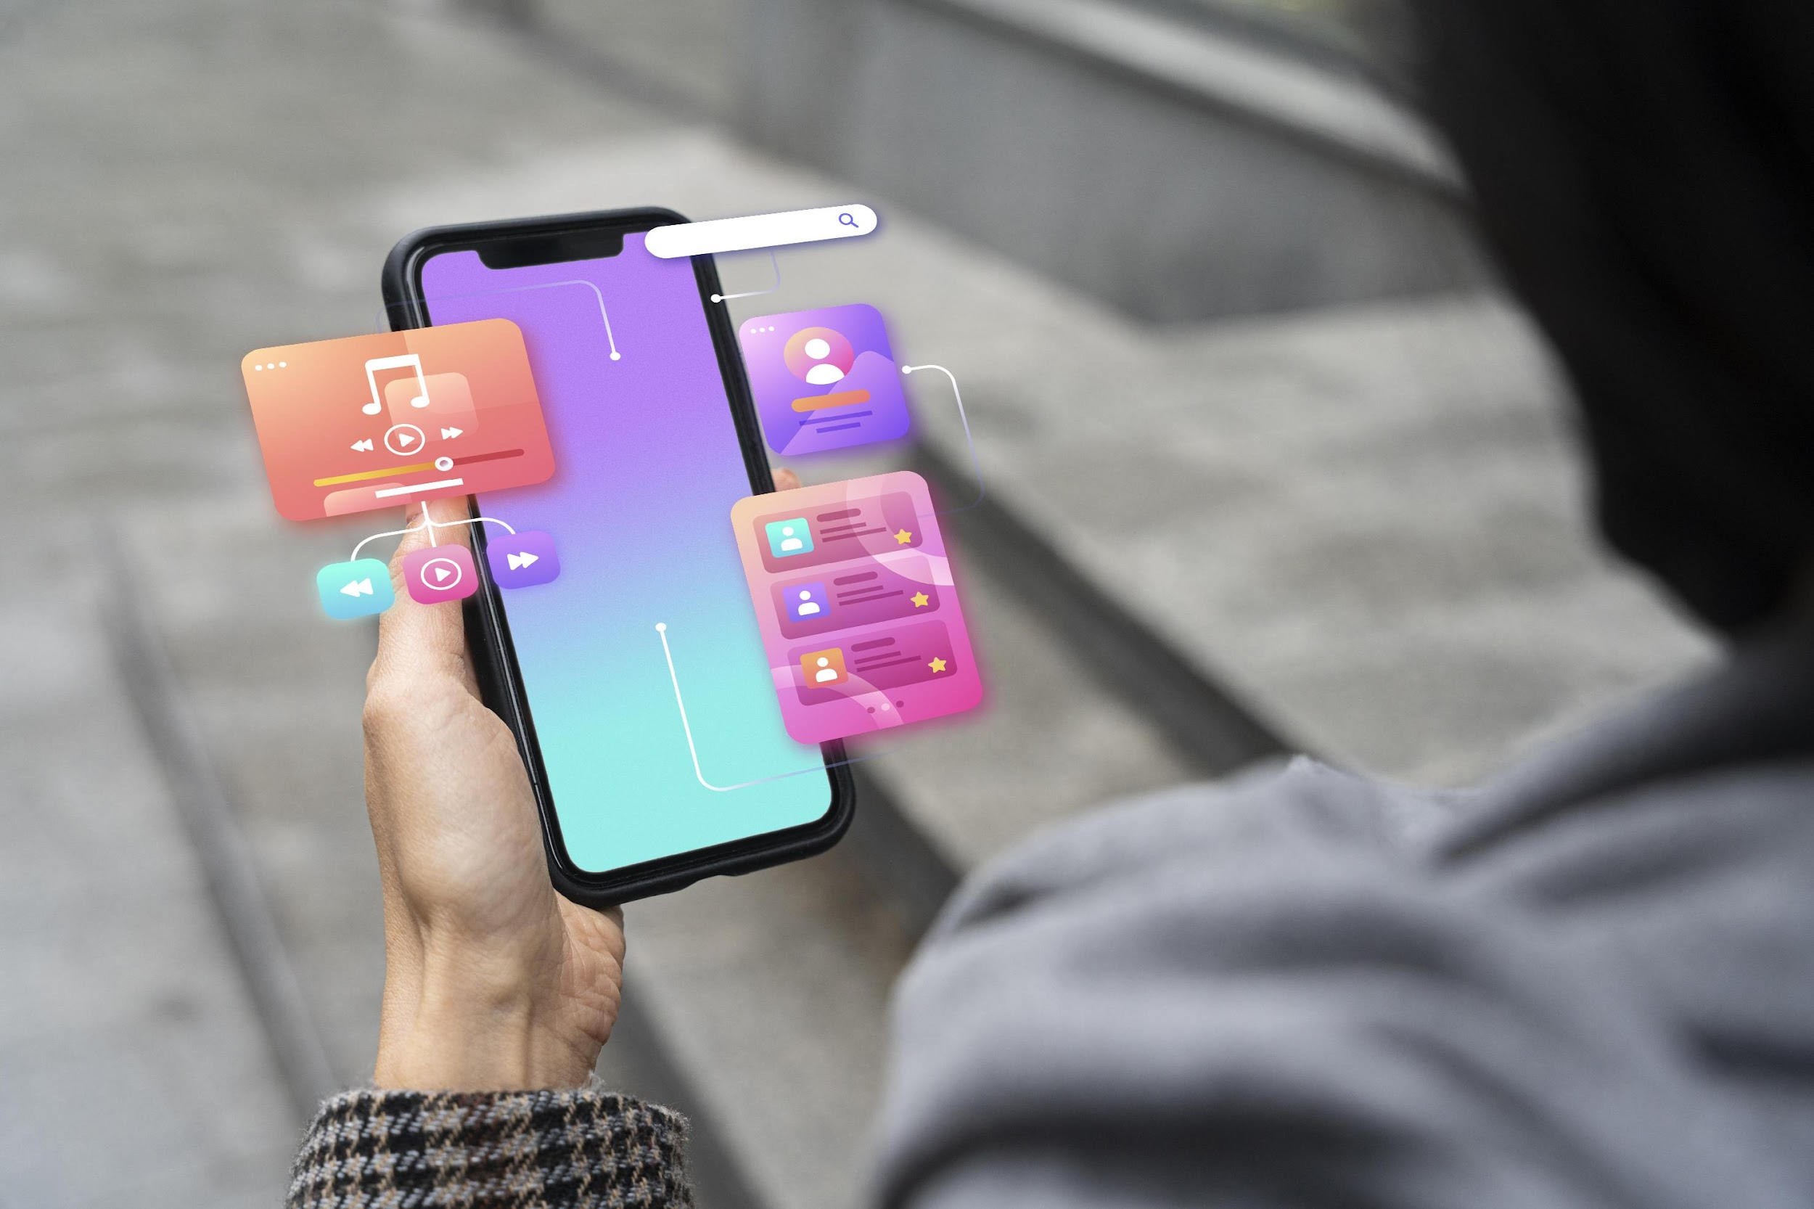
THE FUNDAMENTAL ELEMENTS OF YOUR APP'S UI.
REUSABLE AND COMPOSABLE, ENABLING YOU TO BUILD COMPLEX UIS BY COMBINING SMALLER WIDGETS.
OFFERS A RICH LIBRARY OF PRE-BUILT WIDGETS FOR BASIC AND ADVANCED UI COMPONENTS.
HIGHLY CUSTOMIZABLE, ALLOWING YOU TO TAILOR THEIR APPEARANCE AND BEHAVIOR TO YOUR SPECIFIC NEEDS.
What are Flutter Widgets ?
Notes:
FLUTTER WIDGETS ARE THE FUNDAMENTAL ELEMENTS OF YOUR APP'S UI.
WIDGETS ARE REUSABLE AND COMPOSABLE, ENABLING YOU TO BUILD COMPLEX UIS BY COMBINING SMALLER WIDGETS.
FLUTTER OFFERS A RICH LIBRARY OF PRE-BUILT WIDGETS FOR BASIC AND ADVANCED UI COMPONENTS.
WIDGETS ARE HIGHLY CUSTOMIZABLE, ALLOWING YOU TO TAILOR THEIR APPEARANCE AND BEHAVIOR TO YOUR SPECIFIC NEEDS.

Slide 3

LAYOUTS
Define the overall structure and organization of your app's content.
Provide the framework for placing and arranging your widgets.
,
Common Layouts
Row
Column
Stack
Grid
Padding and Margin
Notes:
What are layouts ?
Layouts define the overall structure and organization of your app's content.
They provide the framework for placing and arranging your widgets.
Now, lets discuss some common Widgets
Row
Column
Stack
Grid
Padding and Margin
from the next slide onwards, we can see these layouts in detail.

Slide 4
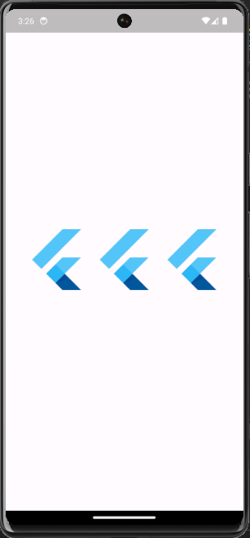
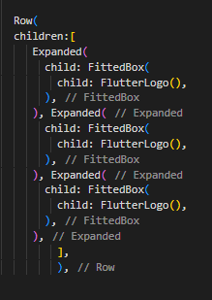
Row
Notes:
Row Widget: Arrange widgets horizontally in a single line.

Slide 5
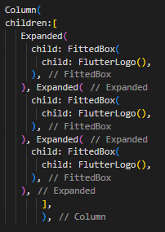
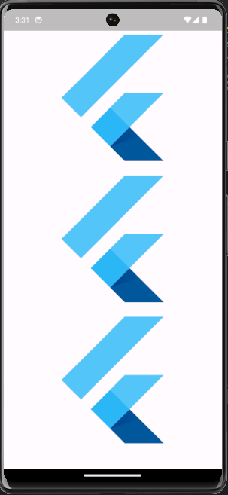
Column
Notes:
Column Widget: Arrange widgets vertically in a single line.

Slide 6
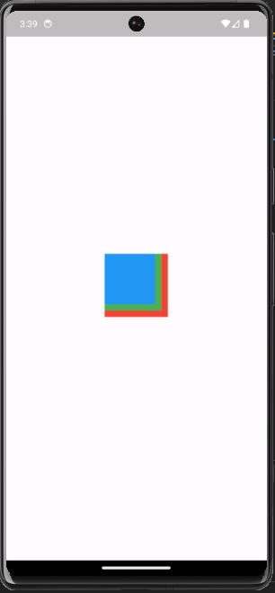
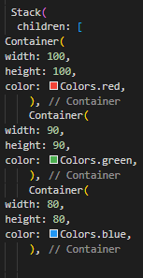
Stack
Notes:
Stack Widget: Overlay widgets on top of each other.

Slide 7
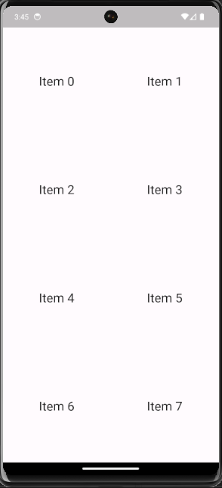
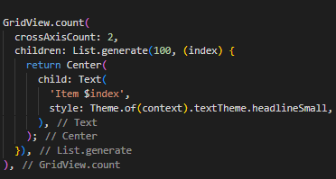
Grid
Notes:
Grid Widget: Arrange widgets in a grid-like layout.

Slide 8
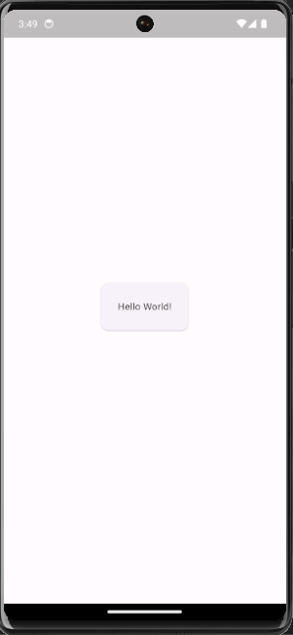
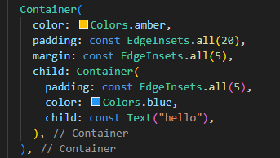
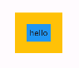
Padding and Margin
Notes:
Padding and Margin: Add spacing between widgets and their container.

Slide 9

Common UI Components:
UI Components
Text:
Display textual content with various styles and formatting options.
Image:
Display images and other visual assets.
Button:
Trigger actions and events when clicked or tapped.
Input Fields:
Allow users to enter text, numbers, or other data.
Icons: Represent concepts and actions visually.
Interactive Elements: UI components are the interactive elements of your app that allow users to interact with it. These components include buttons, text fields, sliders, and more.
Notes:
Interactive Elements: UI components are the interactive elements of your app that allow users to interact with it. These components include buttons, text fields, sliders, and more.
Common UI Components:
Text:
Display textual content with various styles and formatting options.
Image:
Display images and other visual assets.
Button:
Trigger actions and events when clicked or tapped.
Input Fields:
Allow users to enter text, numbers, or other data.
Icons: Represent concepts and actions visually.

Slide 10

SIMPLE USER INTERACTIONS
Flutter allows you to respond to various user gestures, including taps, swipes, and drags. This enables you to build dynamic and interactive UIs.
Common User Interactions:
OnTap
OnSwipe
Long press
Notes:
OnTap: Trigger an action when the widget is tapped.
OnSwipe: Trigger an action when the user swipes across the widget.
Long press: The long-press event is triggered when a user holds down a particular item for some seconds

Slide 11

KEEPING TRACK OF UI DATA: STATE MANAGEMENT:
IT ALLOWS YOU TO STORE AND UPDATE DATA THAT AFFECTS YOUR APP'S UI.
THIS DATA CAN BE ANYTHING FROM USER INPUT TO DYNAMIC VALUES CALCULATED AT RUNTIME.

Slide 12

INTRODUCTION TO THEMING
Consistent Appearance:
Theming allows you to define the overall visual style of your app, including colors, fonts, and other visual elements.
Material Design
It is a set of guidelines for creating beautiful and functional UIs
Customizing Themes
You can customize the default theme or create your own custom theme
Notes:
Consistent Appearance: Theming allows you to define the overall visual style of your app, including colors, fonts, and other visual elements. This helps create a consistent and user-friendly experience.
Material Design: Flutter integrates seamlessly with Material Design, a set of guidelines for creating beautiful and functional UIs
Customizing Themes: You can customize the default theme or create your own custom theme to achieve the desired look and feel for your app.

Slide 13
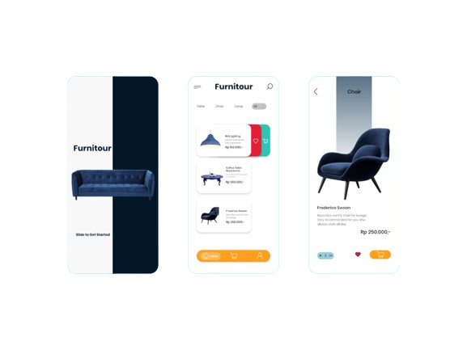
BUILDING COMPLEX UIs: MATERIAL COMPONENTS:
THEY ARE PRE-BUILT WIDGETS THAT IMPLEMENT MATERIAL DESIGN GUIDELINES. THEY PROVIDE A RICH SET OF UI ELEMENTS FOR BUILDING MODERN AND USER-FRIENDLY APPS.
Common Material Components
AppBar
BottomNavigationBar
Card
FloatingActionButton
Dialogs
Notes:
AppBar: Provides a navigation bar and title for your app.
BottomNavigationBar: Enables tab-based navigation between different screens.
Card: Displays structured information with a distinctive design.
FloatingActionButton: Provides a prominent action button for performing key actions.
Dialogs: Display modal windows for confirmations, alerts, and other user interactions

Slide 14
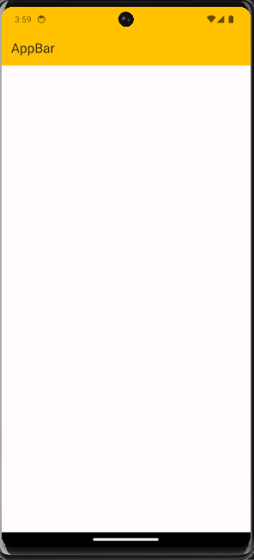
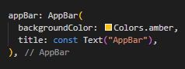
AppBar
Notes:
AppBar: Provides a navigation bar and title for your app.
BottomNavigationBar: Enables tab-based navigation between different screens.
Card: Displays structured information with a distinctive design.
FloatingActionButton: Provides a prominent action button for performing key actions.
Dialogs: Display modal windows for confirmations, alerts, and other user interactions

Slide 15
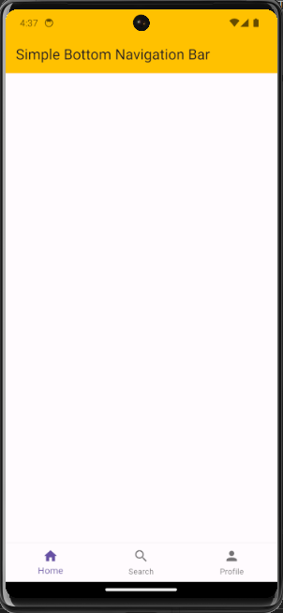
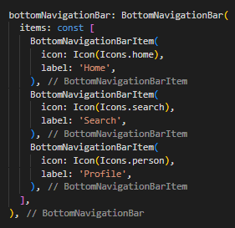
BottomNavigationBar
Notes:
AppBar: Provides a navigation bar and title for your app.
BottomNavigationBar: Enables tab-based navigation between different screens.
Card: Displays structured information with a distinctive design.
FloatingActionButton: Provides a prominent action button for performing key actions.
Dialogs: Display modal windows for confirmations, alerts, and other user interactions

Slide 16
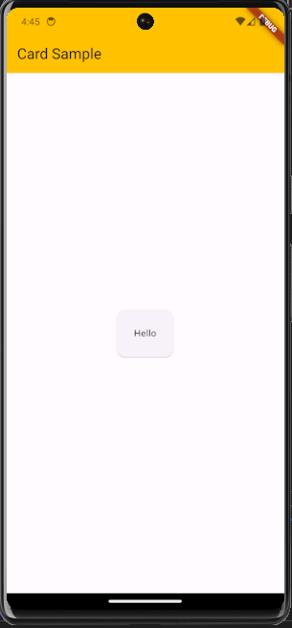
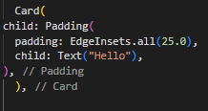
Card
Notes:
AppBar: Provides a navigation bar and title for your app.
BottomNavigationBar: Enables tab-based navigation between different screens.
Card: Displays structured information with a distinctive design.
FloatingActionButton: Provides a prominent action button for performing key actions.
Dialogs: Display modal windows for confirmations, alerts, and other user interactions

Slide 17
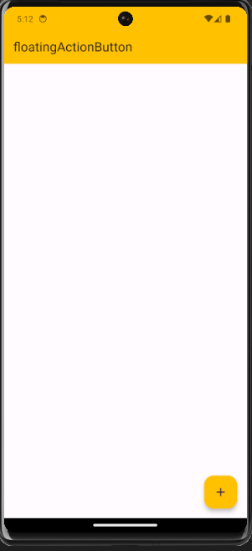
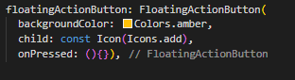
FloatingActionButton
Notes:
AppBar: Provides a navigation bar and title for your app.
BottomNavigationBar: Enables tab-based navigation between different screens.
Card: Displays structured information with a distinctive design.
FloatingActionButton: Provides a prominent action button for performing key actions.
Dialogs: Display modal windows for confirmations, alerts, and other user interactions

Slide 18
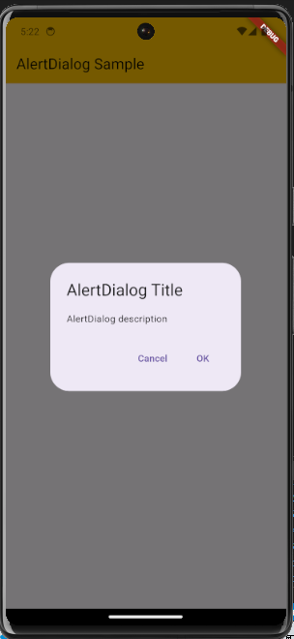
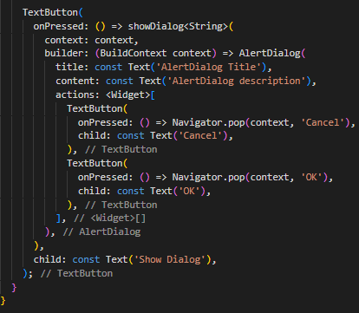
Dialogs
Notes:
AppBar: Provides a navigation bar and title for your app.
BottomNavigationBar: Enables tab-based navigation between different screens.
Card: Displays structured information with a distinctive design.
FloatingActionButton: Provides a prominent action button for performing key actions.
Dialogs: Display modal windows for confirmations, alerts, and other user interactions

Slide 19

ANIMATIONS AND TRANSITIONS
Adding Life and Dynamism: Animations and transitions add visual interest and improve the user experience by making your UI feel more natural and engaging.
Flutter's Animation Framework: Flutter provides a powerful animation framework that allows you to easily use animations.
Notes:
Adding Life and Dynamism: Animations and transitions add visual interest and improve the user experience by making your UI feel more natural and engaging.
Flutter's Animation Framework: Flutter provides a powerful animation framework that allows you to easily use animations.

